Slide 1
Al-Farabi Kazakh National University
Higher School of Medicine
Molecular biomedicine
Lecturer: PhD Pinsky Ilya Vladimirovich

Slide 2
LEARNING OUTCOMES
As a result of the lesson you will be able to:
1. Describe recombinant DNA technology.
2. Discuss about perspectives and dangers of creating the genetically modified
organisms.
3. Describe the use of genetic engineering in the production of vaccines and drugs.
4. Explain the principles of CRISPR-Cas9 technology.
5. Explain what gene therapy is ex vivo and in vivo, analyze the problems and prospects of genomic technologies in medicine.
6. Give definitions of nanotechnology and bionanotechnology.
7. Describe and provide examples of various bionanotechnologies for targeted
delivery of drugs and gene therapy vectors into the cells of the human body.
8. Analyze bionanotechnological methods for the diagnosis and treatment of cancer:
quantum dots, magnetic and radioactive nanoparticles, etc.
9. Analyze the prospects for the use of nanorobots in biomedicine.
10. Give definitions and explain the difference between the terms "pharmacogenomics", "pharmacogenetics", "personalized medicine".
11. Explain how a hereditary predisposition can affect the individual reactions of the human body to drugs and dietary supplements, give specific examples.

Slide 3
Literature:
Weaver, pp. 759-762.
Weaver, pp. 765-784.
Patrick Boisseau, Bertrand Loubaton. Nanomedicine, Nanotechnology in medicine // Comptes rendus hebdomadaires des séances de l’Académie des sciences, Elsevier, 2011. ffhal-00598930
4. https://drrajivdesaimd.com/2014/08/31/gene-therapy/

Slide 4
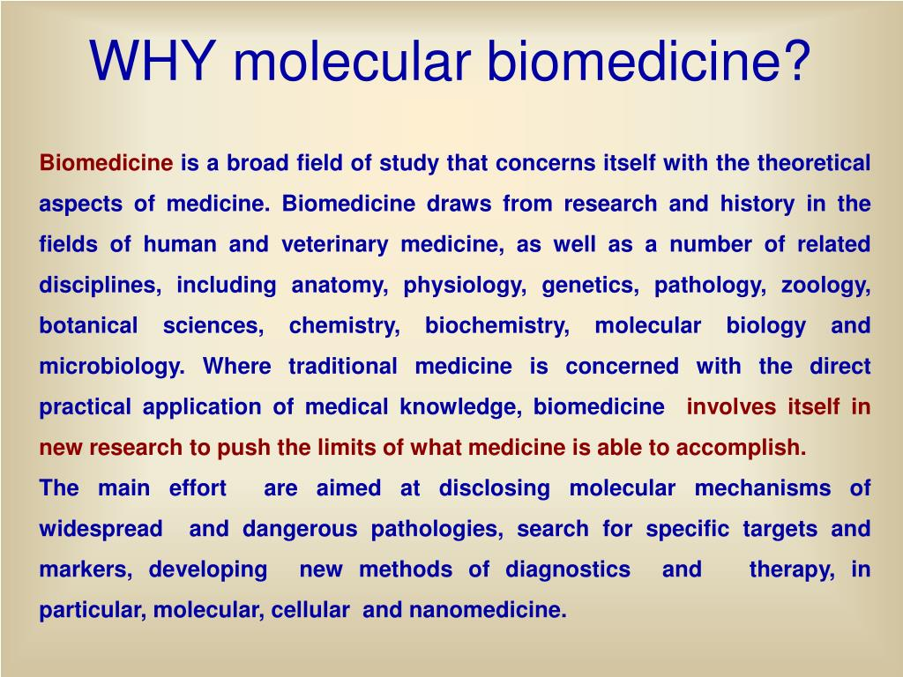
https://www.google.com/url?sa=i&url=https%3A%2F%2Fwww.slideserve.com%2Fkasie%2Fproject-coordinator-prof-acad-nasu-anna-elskaya-16-may-201-2-kyiv-ukraine-powerpoint-ppt-presentation&psig=AOvVaw3bVU9czZd2e_TvfgPt72Mh&ust=1640011538599000&source=images&cd=vfe&ved=0CAwQjhxqFwoTCNjIwN6N8PQCFQAAAAAdAAAAABAP

Slide 5
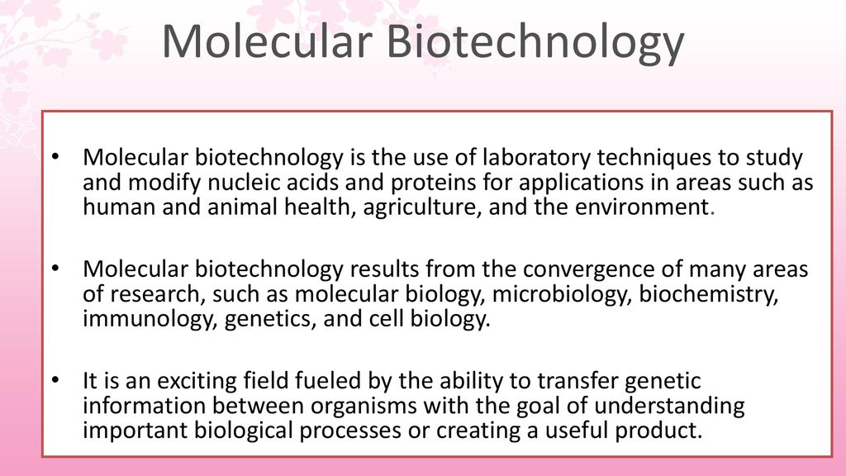
https://www.google.com/url?sa=i&url=https%3A%2F%2Fslideplayer.com%2Fslide%2F14502662%2F&psig=AOvVaw1JuQIo5r7vfWtNWiGa6Z-V&ust=1640011893548000&source=images&cd=vfe&ved=2ahUKEwjGjYHEjvD0AhWHtyoKHQKZCHAQr4kDegUIARCsAQ

Slide 6
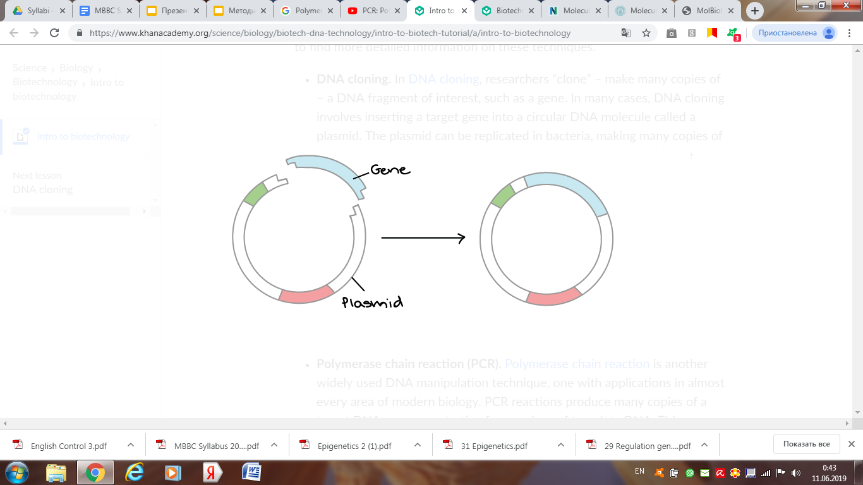
Recombinant DNA technology (DNA cloning).
In DNA cloning, researchers “clone” – make many copies of – a DNA fragment of interest, such as a gene.
In many cases, DNA cloning involves inserting a target gene into a circular DNA molecule called a plasmid.
The plasmid can be replicated in bacteria, making many copies of the gene of interest.
In some cases, the gene is also expressed in the bacteria, making a protein (such as the insulin used by diabetics).

Slide 7
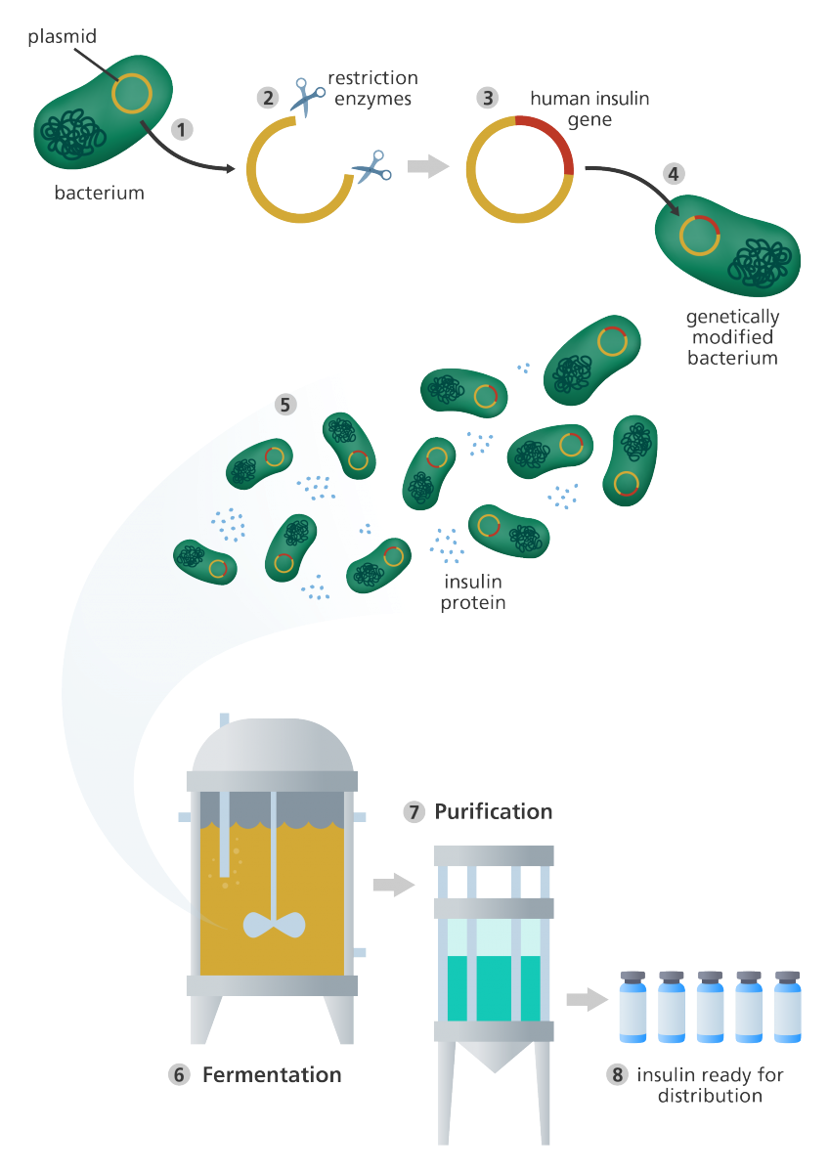
https://www.google.com/url?sa=i&url=https%3A%2F%2Fwww.yourgenome.org%2Ffacts%2Fwhat-is-genetic-engineering&psig=AOvVaw13DoQ_oVXhYjFN6PxQM3sc&ust=1640007231614000&source=images&cd=vfe&ved=0CAwQjhxqFwoTCNCo-Zn97_QCFQAAAAAdAAAAABAD

Slide 8
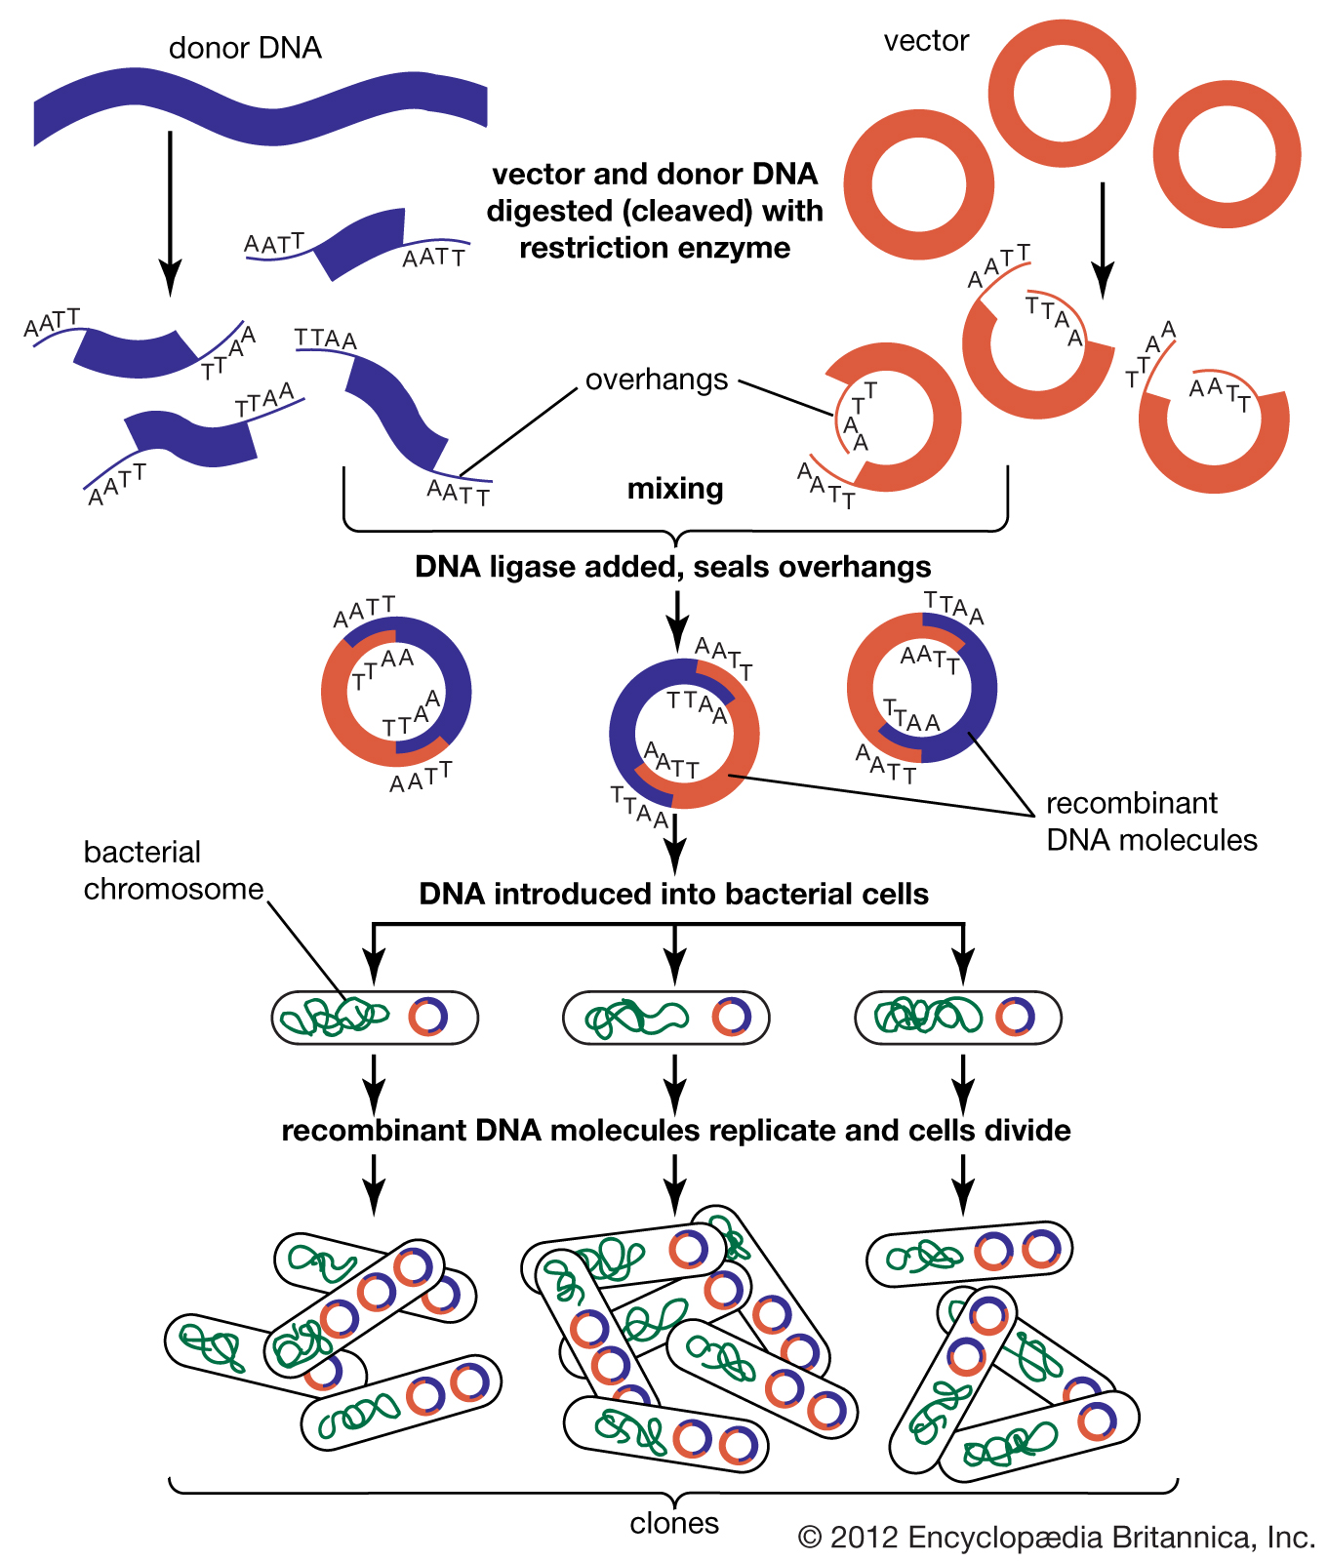

Slide 9
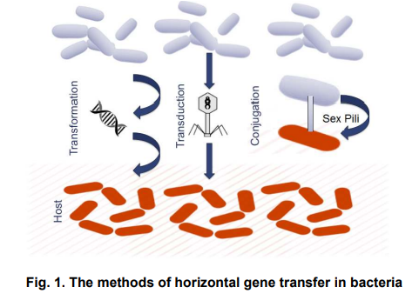
https://www.google.com/url?sa=i&url=https%3A%2F%2Fwww.journalarrb.com%2Findex.php%2FARRB%2Farticle%2Fdownload%2F26159%2F48993%2F&psig=AOvVaw3ihcUvo027ez94CODOK6OI&ust=1640004819258000&source=images&cd=vfe&ved=2ahUKEwi21NyW9O_0AhXXzSoKHayvCQkQr4kDegUIARCrAQ

Slide 10
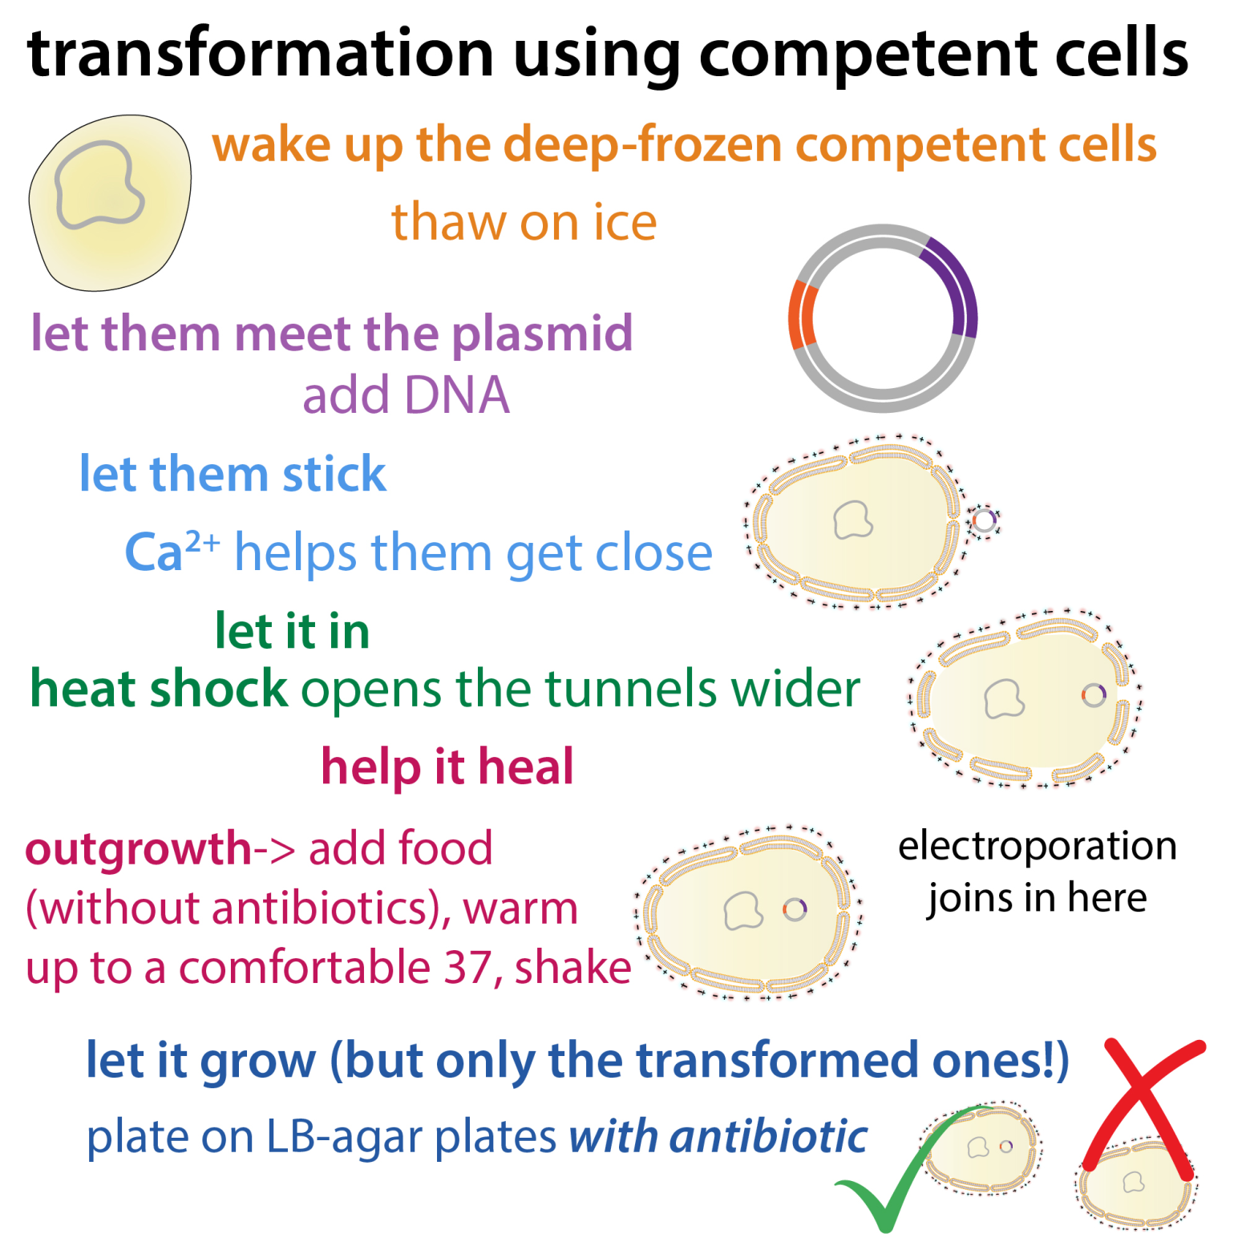
https://www.google.com/url?sa=i&url=https%3A%2F%2Fthebumblingbiochemist.com%2F365-days-of-science%2Fbacterial-transformation-heat-shock-chemically-competent-cells%2F&psig=AOvVaw3ihcUvo027ez94CODOK6OI&ust=1640004819258000&source=images&cd=vfe&ved=0CAwQjhxqFwoTCNDEl5r07_QCFQAAAAAdAAAAABAI

Slide 11
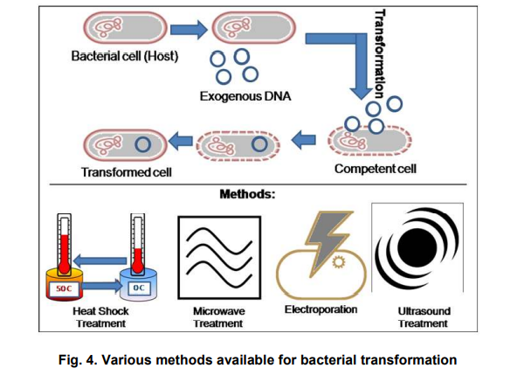
https://www.google.com/url?sa=i&url=https%3A%2F%2Fwww.journalarrb.com%2Findex.php%2FARRB%2Farticle%2Fdownload%2F26159%2F48993%2F&psig=AOvVaw3ihcUvo027ez94CODOK6OI&ust=1640004819258000&source=images&cd=vfe&ved=2ahUKEwi21NyW9O_0AhXXzSoKHayvCQkQr4kDegUIARCrAQ

Slide 12
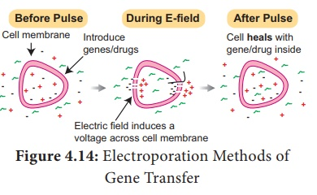
https://www.google.com/url?sa=i&url=https%3A%2F%2Fwww.brainkart.com%2Farticle%2FMethods-of-Gene-Transfer_38242%2F&psig=AOvVaw0nR5E5coZN-8KTqj9HIGkP&ust=1640004674733000&source=images&cd=vfe&ved=0CAwQjhxqFwoTCLi_l9bz7_QCFQAAAAAdAAAAABAS

Slide 13
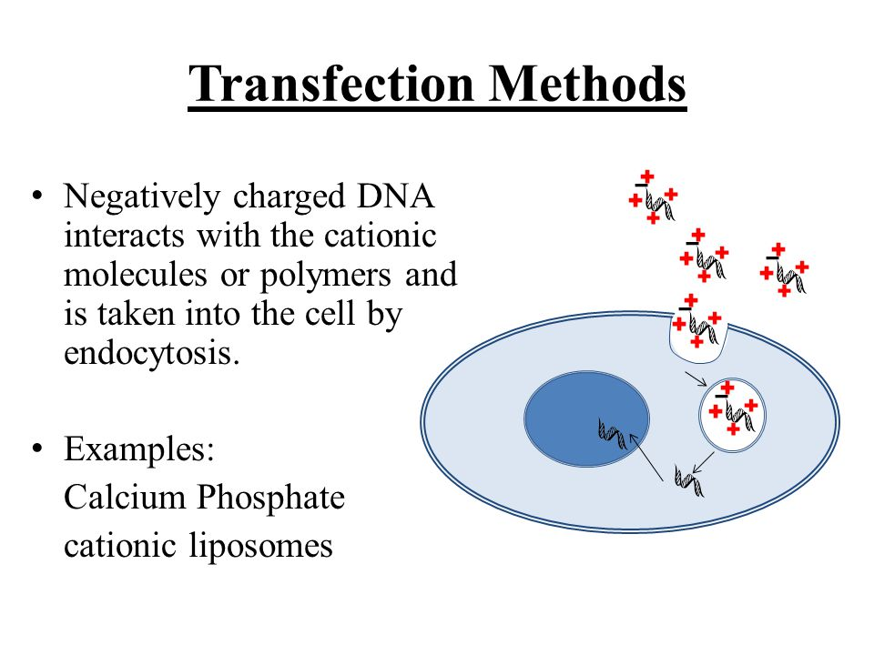
https://www.google.com/url?sa=i&url=https%3A%2F%2Fslideplayer.com%2Fslide%2F5673385%2F&psig=AOvVaw2qaK-VjIoIEnuXKaYa5_sR&ust=1640005725303000&source=images&cd=vfe&ved=0CAwQjhxqFwoTCJDr2dH37_QCFQAAAAAdAAAAABAZ

Slide 14
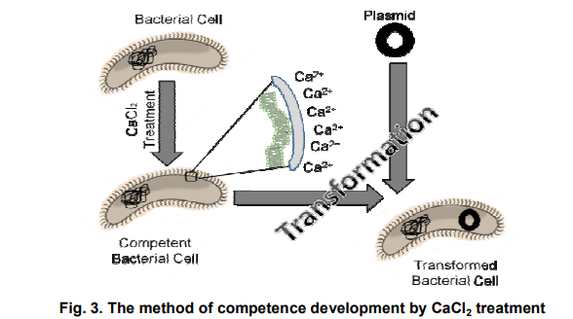
https://www.google.com/url?sa=i&url=https%3A%2F%2Fwww.journalarrb.com%2Findex.php%2FARRB%2Farticle%2Fdownload%2F26159%2F48993%2F&psig=AOvVaw3ihcUvo027ez94CODOK6OI&ust=1640004819258000&source=images&cd=vfe&ved=2ahUKEwi21NyW9O_0AhXXzSoKHayvCQkQr4kDegUIARCrAQ

Slide 15
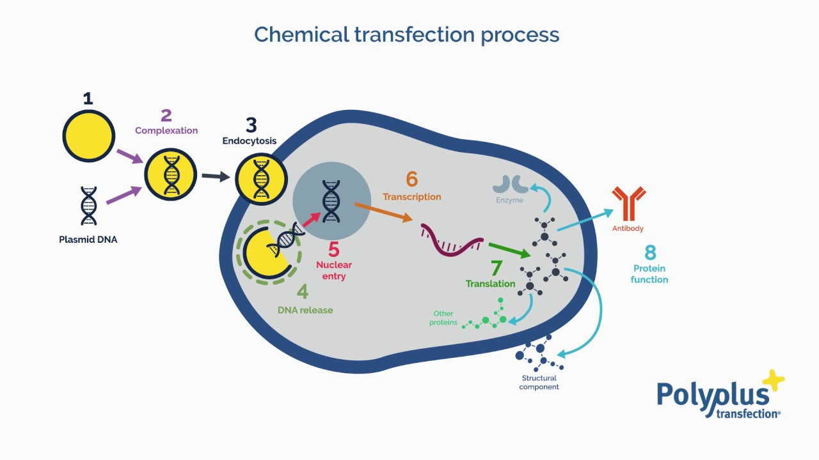
https://www.google.com/url?sa=i&url=https%3A%2F%2Fwww.polyplus-transfection.com%2Fabout-us%2Fwhat-is-transfection%2F&psig=AOvVaw2qaK-VjIoIEnuXKaYa5_sR&ust=1640005725303000&source=images&cd=vfe&ved=0CAwQjhxqFwoTCJDr2dH37_QCFQAAAAAdAAAAABAf

Slide 16
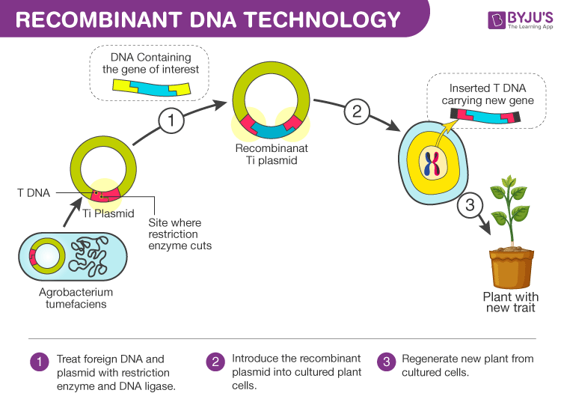
https://www.google.com/url?sa=i&url=https%3A%2F%2Fbyjus.com%2Fbiology%2Frecombinant-dna-technology%2F&psig=AOvVaw33A0aYB_61j_n6yudzHlde&ust=1640004281930000&source=images&cd=vfe&ved=0CAwQjhxqFwoTCJig0Zzy7_QCFQAAAAAdAAAAABAD

Slide 17
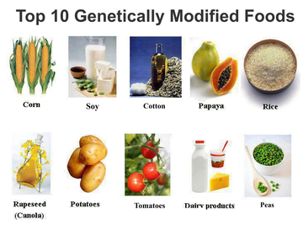
https://www.google.com/url?sa=i&url=https%3A%2F%2Fwww.matherhospital.org%2Fweight-loss-matters%2Fwhats-deal-gmos%2F&psig=AOvVaw1y9f6v7Ash9Fy0NZugX5Xt&ust=1640013007417000&source=images&cd=vfe&ved=0CAwQjhxqFwoTCMjG3NmS8PQCFQAAAAAdAAAAABAD

Slide 18
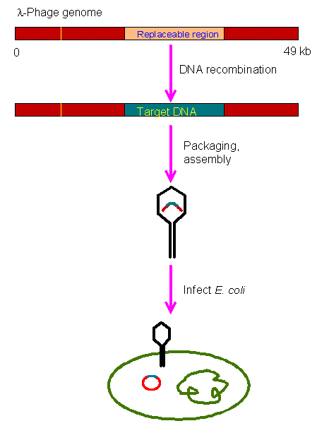
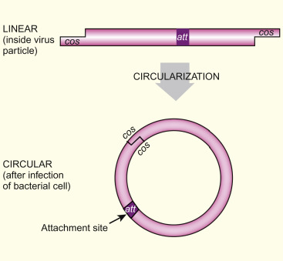
https://www.google.com/url?sa=i&url=https%3A%2F%2Fwww.sciencedirect.com%2Ftopics%2Fimmunology-and-microbiology%2Fenterobacteria-phage-lambda&psig=AOvVaw26PA1iUbPGMKC2_-RQc6c9&ust=1640009570185000&source=images&cd=vfe&ved=0CAwQjhxqFwoTCMD_5vKF8PQCFQAAAAAdAAAAABA4
https://www.google.com/url?sa=i&url=https%3A%2F%2Fwww.web-books.com%2FMoBio%2FFree%2FCh9A4.htm&psig=AOvVaw26PA1iUbPGMKC2_-RQc6c9&ust=1640009570185000&source=images&cd=vfe&ved=0CAwQjhxqFwoTCMD_5vKF8PQCFQAAAAAdAAAAABA9

Slide 19
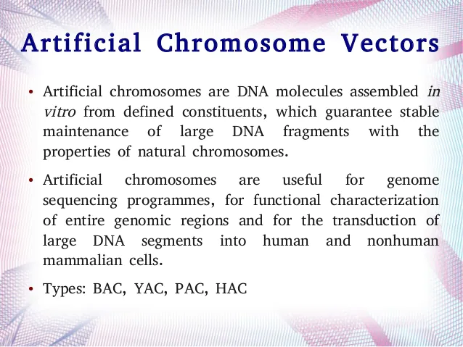
https://www.google.com/url?sa=i&url=https%3A%2F%2Fwww.slideshare.net%2Fag1805x%2Fartificial-vectors&psig=AOvVaw2J8-u6nIGW3cNrVJJQkPR5&ust=1640008987808000&source=images&cd=vfe&ved=0CAwQjhxqFwoTCNDBs-GD8PQCFQAAAAAdAAAAABBP

Slide 20
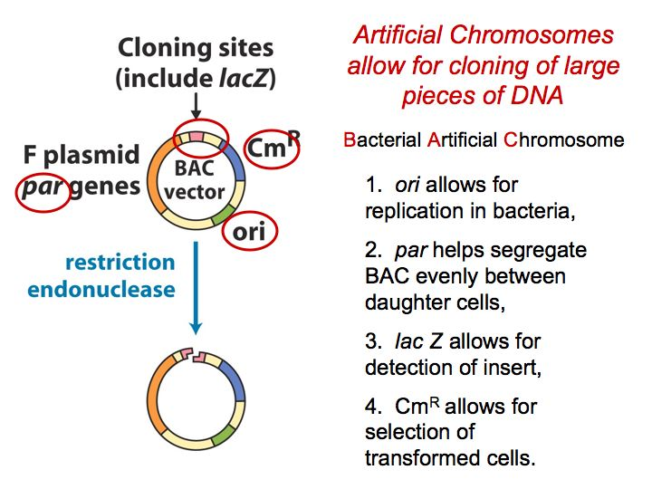
https://www.google.com/url?sa=i&url=https%3A%2F%2Flibrary.uams.edu%2Fassets%2FCOM%2FBioChem%2FMolecularTools%2FMolecularToolsSDL12.html&psig=AOvVaw2J8-u6nIGW3cNrVJJQkPR5&ust=1640008987808000&source=images&cd=vfe&ved=0CAwQjhxqFwoTCNDBs-GD8PQCFQAAAAAdAAAAABAN

Slide 21
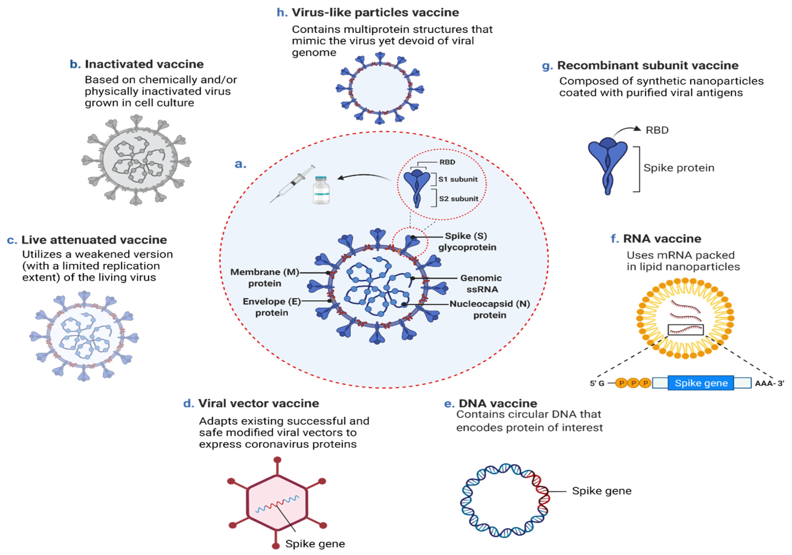
https://www.google.com/url?sa=i&url=https%3A%2F%2Fwww.mdpi.com%2F2076-393X%2F9%2F10%2F1196%2Fhtm&psig=AOvVaw03g5GN_kF-BuGIS9JSyjBM&ust=1640006032758000&source=images&cd=vfe&ved=0CAwQjhxqFwoTCJC-uN747_QCFQAAAAAdAAAAABBd

Slide 22
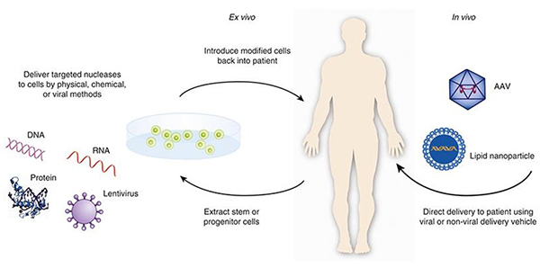
https://www.google.com/url?sa=i&url=https%3A%2F%2Fwww.fda.gov%2Fvaccines-blood-biologics%2Fcellular-gene-therapy-products%2Fwhat-gene-therapy&psig=AOvVaw1Ftk6rMfxpvSCkQAU5GS40&ust=1640109680311000&source=images&cd=vfe&ved=2ahUKEwifua_o-vL0AhXP_CoKHR2qA3wQr4kDegUIARDKAQ

Slide 23
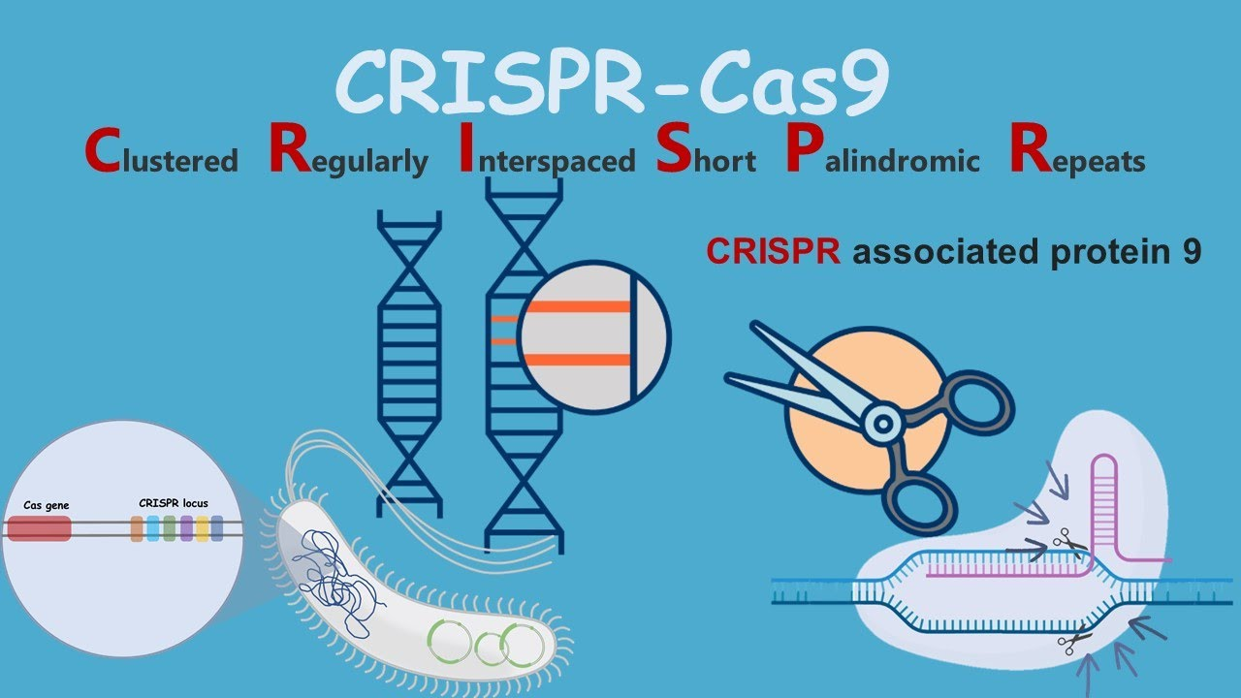
CRISPR-Cas9 : Introduction and discovery
youtube.com

Slide 24
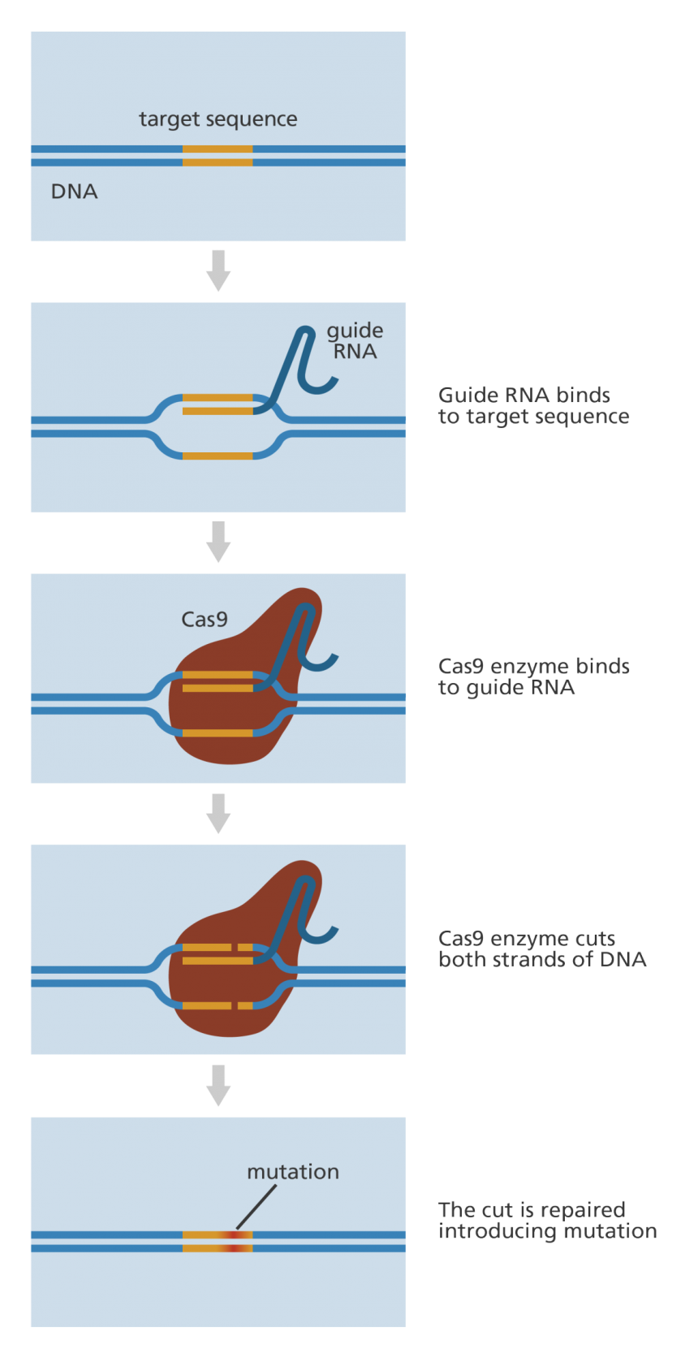
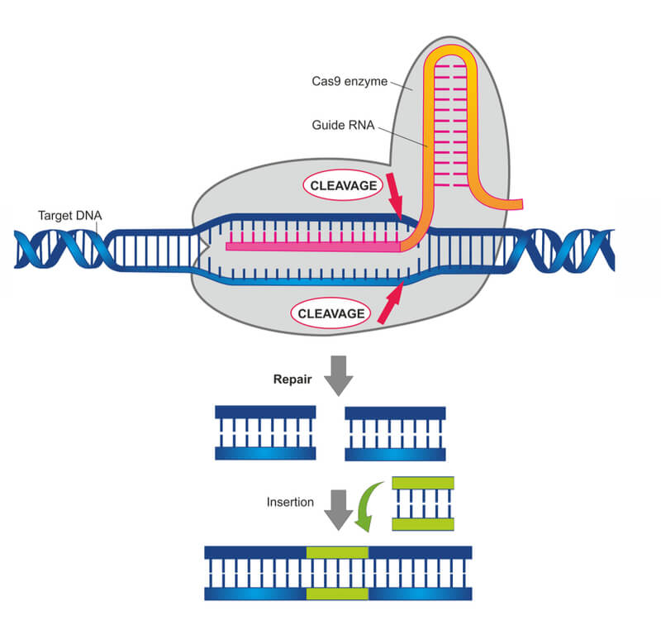
https://www.google.com/url?sa=i&url=https%3A%2F%2Fwww.labiotech.eu%2Fin-depth%2Fcrispr-cas9-review-gene-editing-tool%2F&psig=AOvVaw0htv8U8KM1c-1LzKt6PlGE&ust=1640007643005000&source=images&cd=vfe&ved=2ahUKEwjexJjZ_u_0AhWlmIsKHSdrClAQr4kDegUIARDJAQ
https://www.google.com/url?sa=i&url=https%3A%2F%2Fwww.yourgenome.org%2Ffacts%2Fwhat-is-crispr-cas9&psig=AOvVaw0htv8U8KM1c-1LzKt6PlGE&ust=1640007643005000&source=images&cd=vfe&ved=0CAwQjhxqFwoTCJCHx9v-7_QCFQAAAAAdAAAAABBw

Slide 25
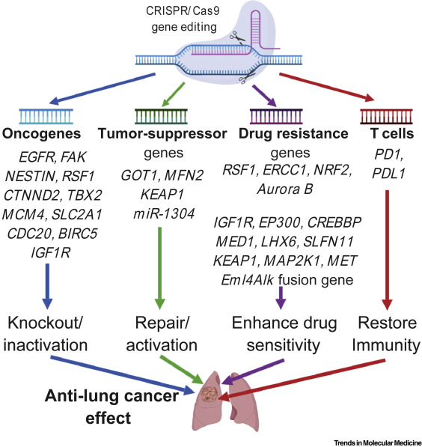
https://www.google.com/url?sa=i&url=https%3A%2F%2Fwww.cell.com%2Ftrends%2Fmolecular-medicine%2Ffulltext%2FS1471-4914(19)30184-4&psig=AOvVaw0htv8U8KM1c-1LzKt6PlGE&ust=1640007643005000&source=images&cd=vfe&ved=0CAwQjhxqGAoTCJCHx9v-7_QCFQAAAAAdAAAAABCMAQ

Slide 26
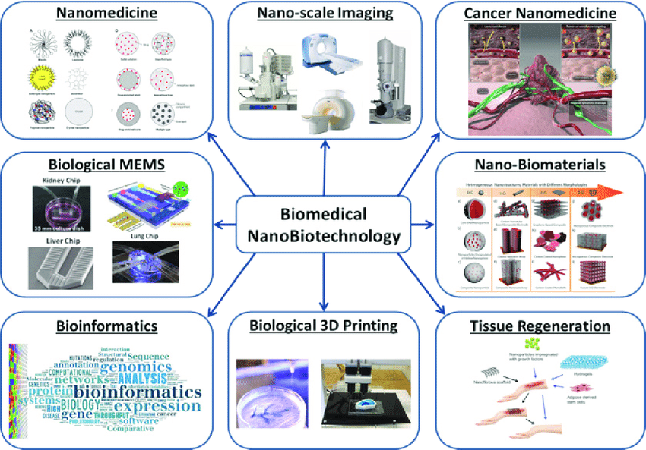
https://www.google.com/url?sa=i&url=https%3A%2F%2Fwww.researchgate.net%2Ffigure%2FBiomedical-Nanotechnology-Applications-Nano-scale-Imaging-Cancer-Nanomedicine_fig2_326740357&psig=AOvVaw2M8Hr7vKObutZznK4p1WMY&ust=1640008694609000&source=images&cd=vfe&ved=0CAwQjhxqFwoTCLir-dCC8PQCFQAAAAAdAAAAABAD

Slide 27
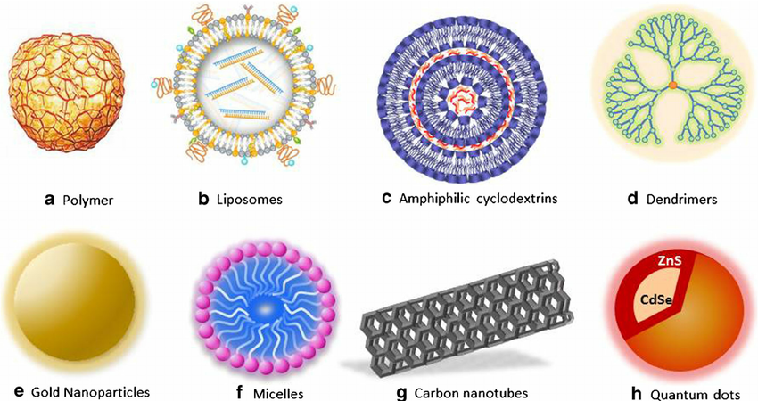
https://www.google.com/url?sa=i&url=https%3A%2F%2Fwww.researchgate.net%2Ffigure%2FDifferent-types-of-nanoparticles-commonly-used-for-biomedical-applications-and-which_fig2_269182214&psig=AOvVaw2x-e49Q5FJZrlkEMGyXShv&ust=1640009953189000&source=images&cd=vfe&ved=0CAwQjhxqFwoTCNCIwa2H8PQCFQAAAAAdAAAAABAS

Slide 28
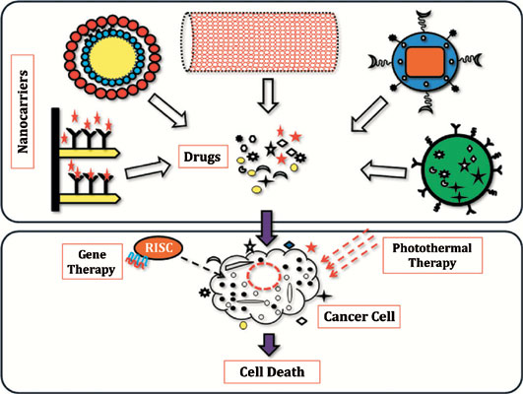
https://www.google.com/url?sa=i&url=https%3A%2F%2Fwww.eurekaselect.com%2F165536%2Farticle&psig=AOvVaw291R9wjorEaYDcgn5AguoG&ust=1640012144900000&source=images&cd=vfe&ved=0CAwQjhxqFwoTCMjI972P8PQCFQAAAAAdAAAAABB4

Slide 29
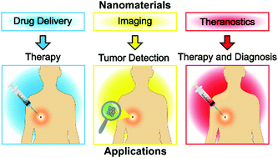
https://www.google.com/url?sa=i&url=https%3A%2F%2Fpubs.rsc.org%2Fen%2Fcontent%2Farticlelanding%2F2018%2Fnr%2Fc8nr02796j&psig=AOvVaw291R9wjorEaYDcgn5AguoG&ust=1640012144900000&source=images&cd=vfe&ved=0CAwQjhxqGAoTCMjI972P8PQCFQAAAAAdAAAAABCwAQ

Slide 30
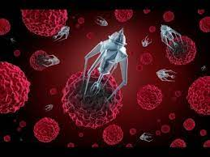
https://www.google.com/url?sa=i&url=https%3A%2F%2Fthenanoshield.com%2Fbiomedical-nanotechnology-market-2020-exclusive-demand-with-product-type-application-and-competitive-landscape-advanced-diamond-technologies-inc-us-advanced-nano-products-co%2F&psig=AOvVaw2M8Hr7vKObutZznK4p1WMY&ust=1640008694609000&source=images&cd=vfe&ved=2ahUKEwiRrNHOgvD0AhWIp4sKHY_dAn8Qr4kDegUIARC_AQ

Slide 31
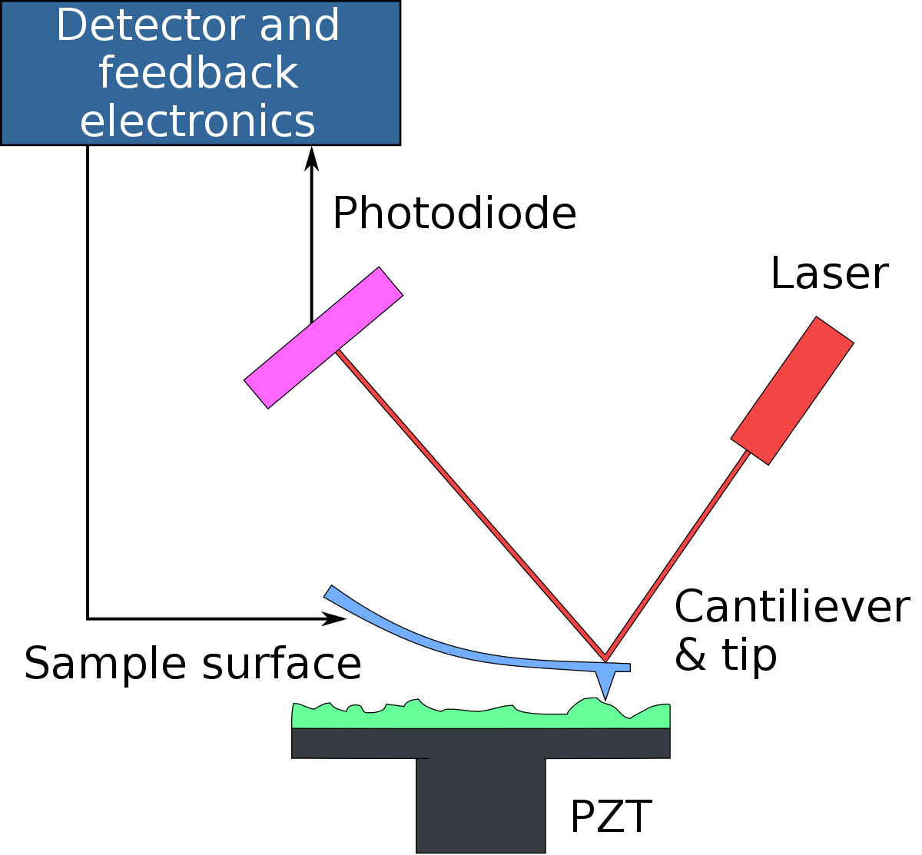
Atomic force microscopy - Wikipedia
en.wikipedia.org

Slide 32
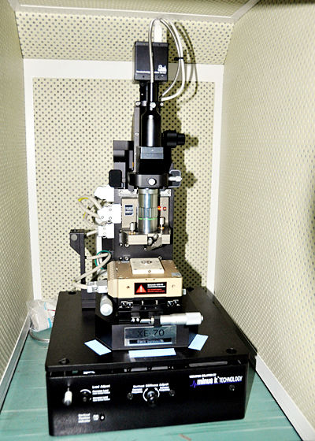
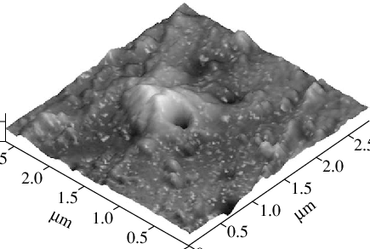
Three-dimensional atomic-force image of the surface
researchgate.net
Atomic Force Microscope
iitk.ac.in

Slide 33
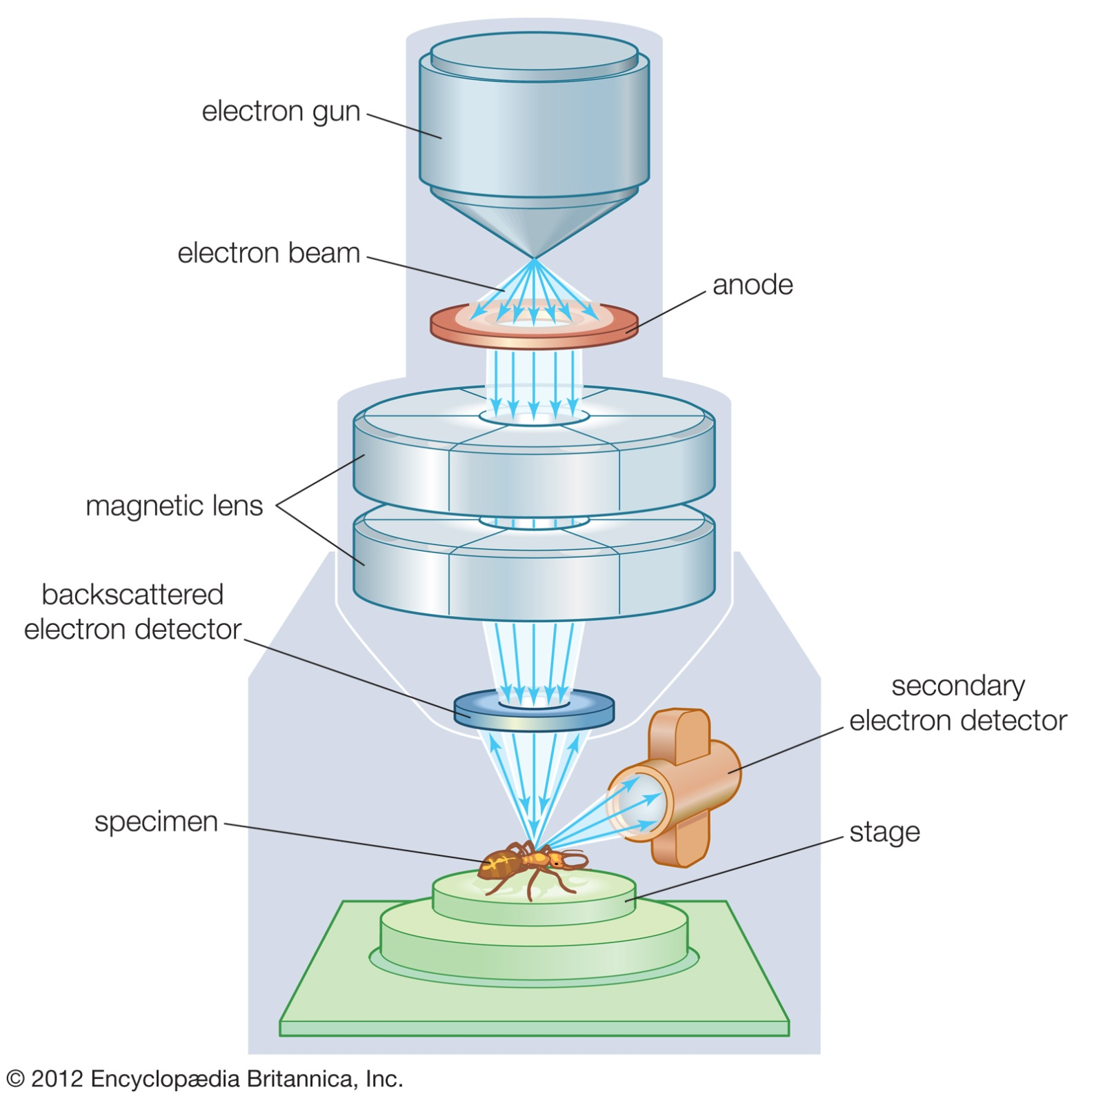
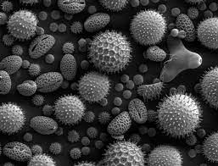
Scanning electron microscope - Wikipedia
en.wikipedia.org

Slide 34
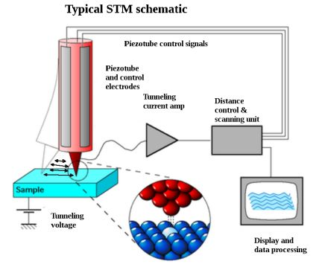
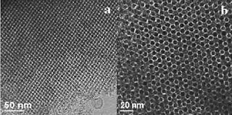
Tunneling electron microscopy images
researchgate.net
Scanning tunneling microscope
testandmeasurementtips.com

Slide 35
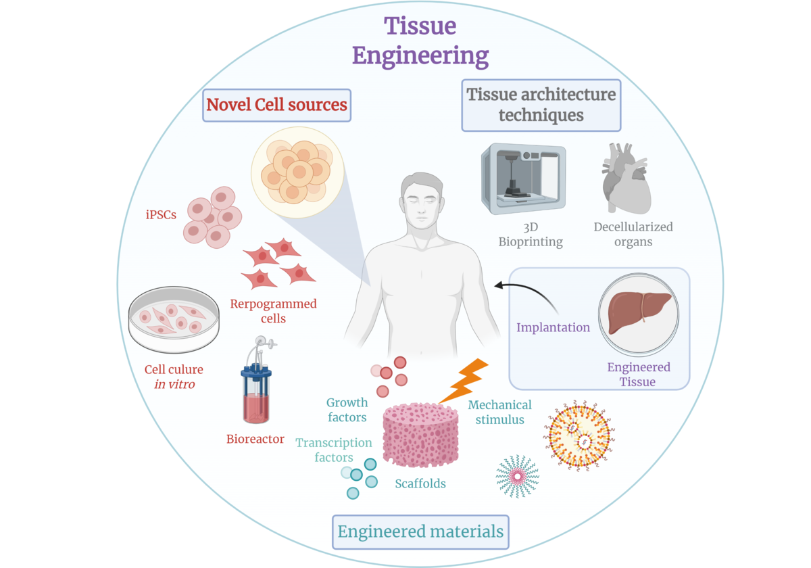
Tissue engineering - Wikipedia
en.wikipedia.org

Slide 36
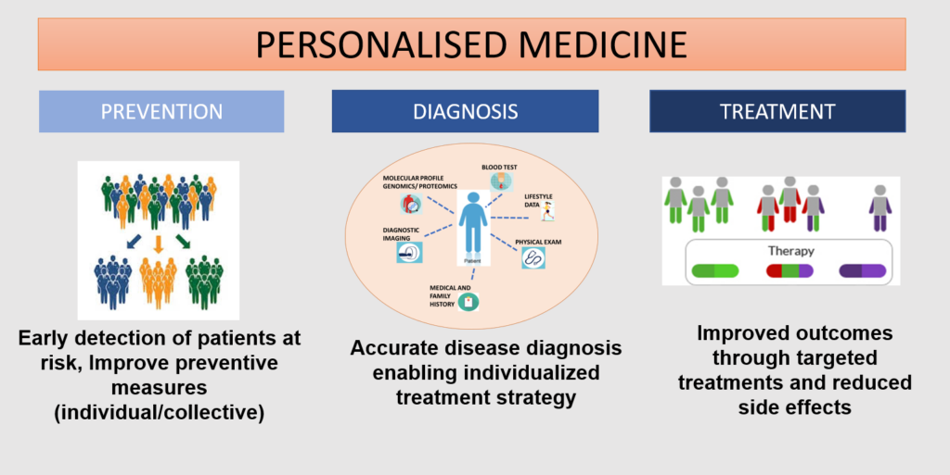
https://www.google.com/url?sa=i&url=https%3A%2F%2Fwww.eulac-permed.eu%2Findex.php%2Fwhat-is-personalised-medicine%2F&psig=AOvVaw2YmZVboHSPR-HsjGnJObxM&ust=1640011217333000&source=images&cd=vfe&ved=0CAwQjhxqFwoTCNCG5oSM8PQCFQAAAAAdAAAAABAD

Slide 37
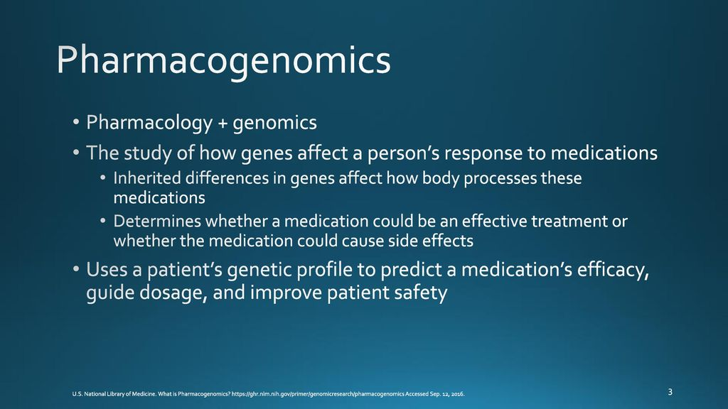
https://www.google.com/url?sa=i&url=https%3A%2F%2Fslideplayer.com%2Fslide%2F12231186%2F&psig=AOvVaw2UXlowR0tXyMknRY7xluw9&ust=1640010794651000&source=images&cd=vfe&ved=0CAwQjhxqFwoTCMjP_ruK8PQCFQAAAAAdAAAAABAS

Slide 38
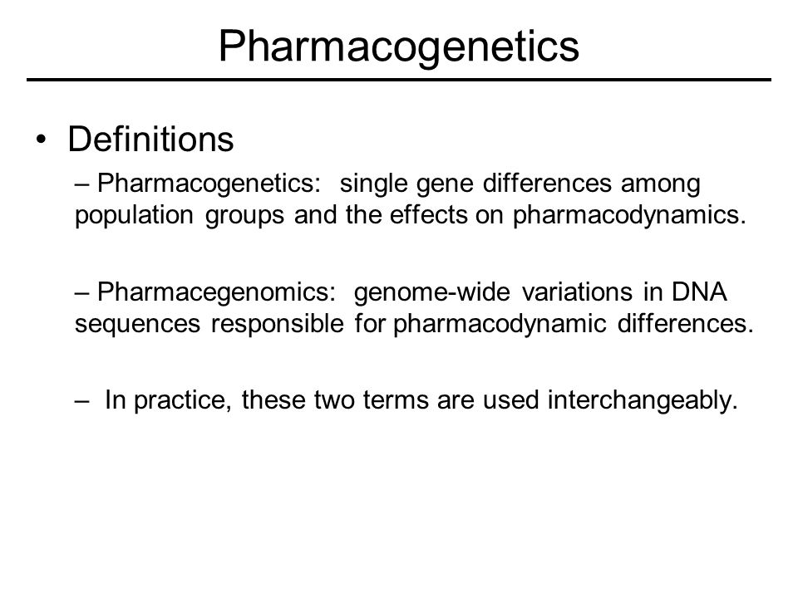
https://www.google.com/url?sa=i&url=https%3A%2F%2Fslideplayer.com%2Fslide%2F7234180%2F&psig=AOvVaw2UXlowR0tXyMknRY7xluw9&ust=1640010794651000&source=images&cd=vfe&ved=0CAwQjhxqFwoTCMjP_ruK8PQCFQAAAAAdAAAAABAn

